Slide 1
About this template
Do not modify this template’s design
Make sure no font is smaller than 28 p.
Exception: references and notes (18 p)
Your presentation will start with the next slide. Feel free to add more slides.
Why this format?
It is visually simple, so you can spend your time focused on content and ideas.
It helps you to avoid too much time spent on a slide.
This is not a PowerPoint class.
Be ready to present from Maciej’s laptop

Slide 2
Title: Do students’ last names reflect their personalities?
Team members:
Alex Brave
Joe Courageous

Slide 3
Hook & Research Question
Start with an interesting fact/statistic that draws attention
Present the core question
Why should the audience care?

Slide 4
Hook & Research Question cont.
Present the best of your additional questions
Why should the audience care?

Slide 5
The Data Story
Brief dataset introduction
1-2 key challenges faced (e.g., data cleaning)
How these challenges were solved (highlighting technical skills)

Slide 6
Key Finding #1
Lead with the discovery
Show primary visualization
If interactive, we can switch to your notebook
Brief explanation of technical approach (Python function/analysis that revealed this)

Slide 7
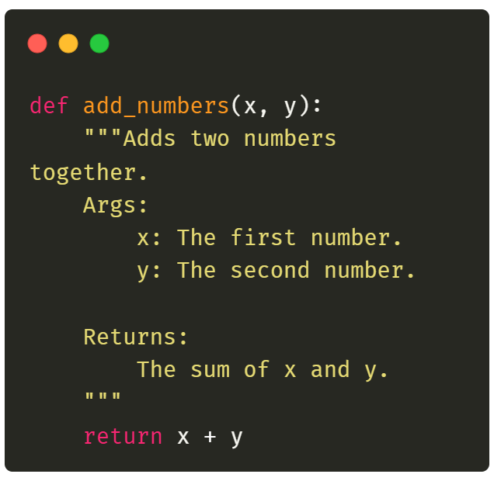
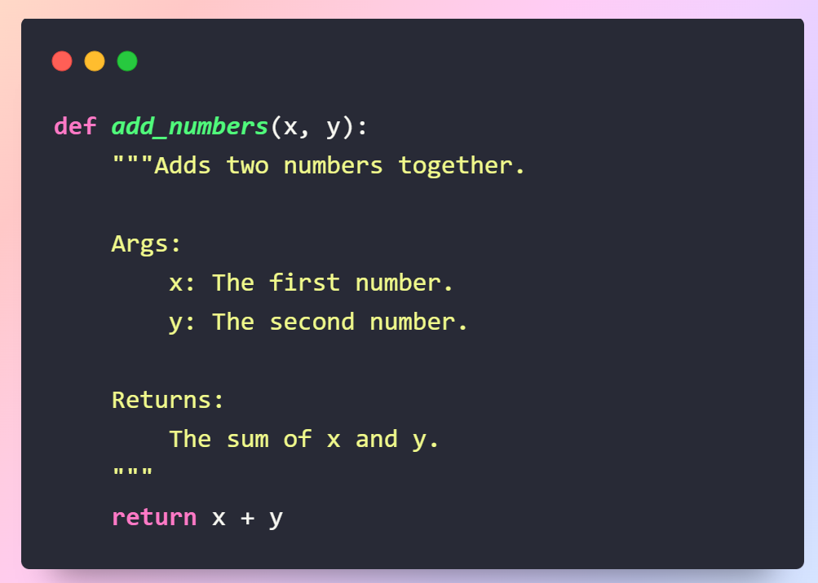
Key Finding #1 cont.
BTW, you can include brief code snippets.
These two website can make them pretty for you:
https://10015.io/tools/code-to-image-converter
https://carbon.now.sh/

Slide 8
Key Finding #2
Second major discovery
Supporting visualization
If interactive, we can switch to your notebook
Brief mention of the technical approach

Slide 9
Unexpected Discovery (optional)
Something surprising found during the analysis
This can be an unexpected finding or an unexpected technical challenge
Visualization of the finding or discussion of how the challenge was addressed

Slide 10
Impact & Conclusions
Answer(s) to research question(s)
Real-world implications
Future directions (If someone gave your team one month of free time and $100,000, what else could you do?)

Slide 11
Last slide
References
Acknowledgments
Contact information

